Slide 1
Stock Prophets:
Project 4 Group 6

Slide 2
Team

Slide 3
Overview
Allow user to interact with our flask app to provide stock ticker predictions for the next 7 days as well as the historical data
To get there
Reliable data source
Create csv for sqlite
Machine learning model to predict
Performance of models
Notes:
Kelly

Slide 4
Data
Using yfinance library in python
Nasdaq – stock ticker names
Time period for data = 01/01/2010 to present or date the ticker went public after 1/1/10
Note: Time periods are based on the life of the stock
Historical price data per ticker: (Note: Doesn’t include emotional sentiment or newsworthy events impacting prices)
Data prepped prior to storing in dbs
Databases used: SQLite MongoDB
Notes:
Josh

Slide 5
Machine Learning Model 1
Linear Regression – main model
80% Training 20% Testing
Screen shot
Notes:
Mohamed

Slide 6
Machine Learning Model 2
LSTM –
Limited data
Long time to process
Notes:
Michael

Slide 7
Machine Learning Model 3
ARIMA
Notes:
Indra

Slide 8
Accuracy of Models
R2 score for Linear Regression: 0.98
R2 score for LSTM Model 2: 0.97
R2 score for ARIMA Model : 0.93
Notes:
Giovanna

Slide 9
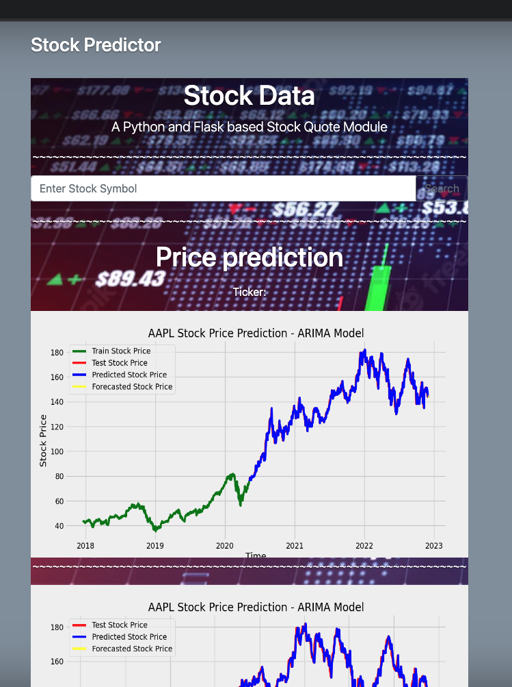
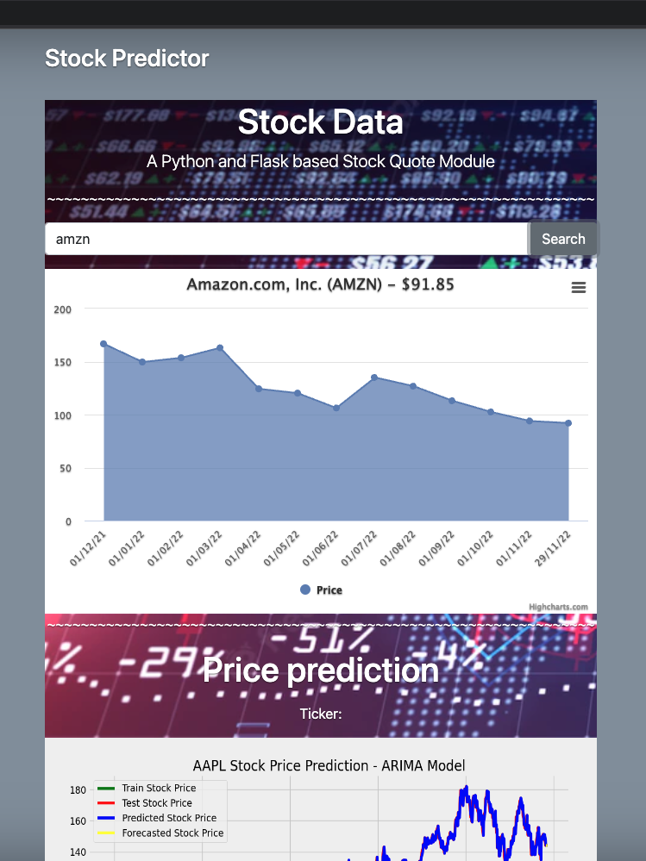
Flask App Dashboard
User-interaction dashboard
Using Python Flask, JavaScript, HTML and MongoDB to create
Using ARIMA Model – Classification
highest Accuracy among the models
Show the stock trend for each ticker requested
Predicts up to 7 calendar days ahead
Notes:
Selina

Slide 10
99 Problems…
Trouble passing user-defined ticker symbol to the models
Matplotlib or DIE! – Dependencies forgotten
The Never-Ending Loop Loop Loop Loop
Plt.show or HIDE? To return only dfs
Adding MongoDB to overcome pulling 1000s of rows from csv
MatplotDEAD – used pngs to display the results
Notes:
Marjorie

Slide 11
But the demo isn’t one

Slide 12
Future Project Considerations
Incorporate emotional sentiment and news data
Limit predictions to “open market days”
Allow user-defined start date of historical data look-up
Allow for stock comparisons of different tickers
Predict from quarterly earnings
Industry specific predictions
ETF/ Mutual Funds / Crypto / Options
SELL SELL SELL
Notes:
Miranda

